Slide 1
MONASH INFORMATION
TECHNOLOGY
Machine Learning- Featurization
Prajwol Sangat
Updated by CM Ting (15 April 2022)
Notes:
is Featurization.

Slide 2
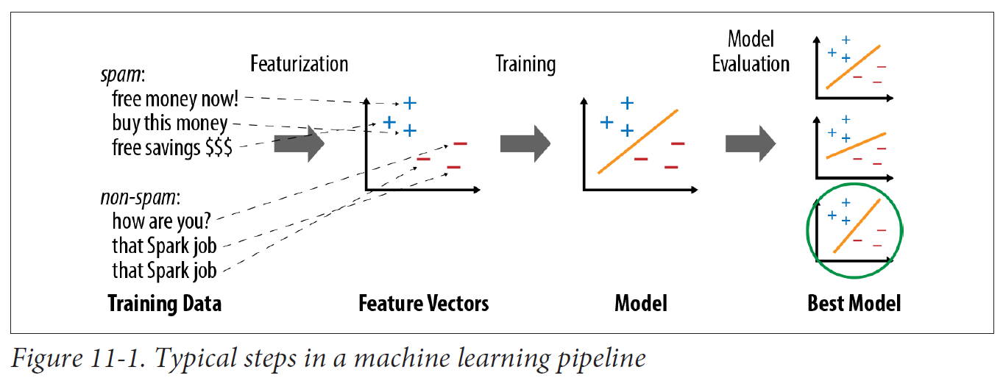
Machine Learning: Pipeline

Slide 3
Machine Learning: Pipeline

Slide 4
Featurization: Extraction, transformation and selection
Extraction
Extracting features from “raw” data
Transformation
Scaling, converting, or modifying features
Selection
Selecting a subset from a larger set of features

Slide 5
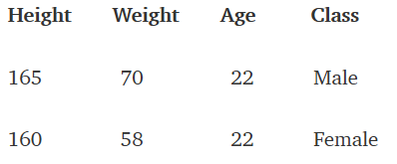
Featurization: Feature Extraction and Transformation
Features
Any machine learning algorithm requires some training data. In training data we have values for all features for all historical records. Consider this simple data set
We can prepare training data by following two techniques
Feature Extraction
Feature Selection

Slide 6
Featurization: Feature Extraction and Transformation
Feature extractors
CountVectorizer
TF-IDF
Word2Vec
FeatureHasher (In tutorial)

Slide 7
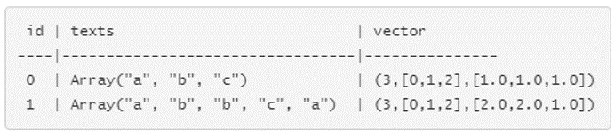
Featurization: Feature Extractors
Count Vectorizer
Convert a collection of text documents to vectors of token counts.
During the fitting process, Count Vectorizer will select the top vocabSize words ordered by term frequency across the corpus.

Slide 8
Featurization: Feature Extractors
Term Frequency–Inverse Document Frequency, or TF-IDF,
A simple way to generate feature vectors from text documents (e.g., web pages).
It computes two statistics for each term in each document:
The term frequency (TF), which is the number of times the term occurs in that document, and
The inverse document frequency (IDF), which measures how (in)frequently a term occurs across the whole document corpus.

Slide 9

Featurization: Feature Extractors
Term Frequency–Inverse Document Frequency, or TF-IDF,
Denote a term by t, a document by d, and the corpus by D.
Term frequency TF(t,d) is the number of times that term t appears in document d, while document frequency DF(t,D) is the number of documents that contains term t.
Inverse document frequency is a numerical measure of how much information a term provides:
where |D| is the total number of documents in the corpus.

Slide 10

Featurization: Feature Extractors
Term Frequency–Inverse Document Frequency, or TF-IDF,
The product of these values, TF × IDF, shows how relevant a term is to a specific document (i.e., if it is common in that document but rare in the whole corpus).
The TF-IDF measure is simply the product of TF and IDF:

Slide 11
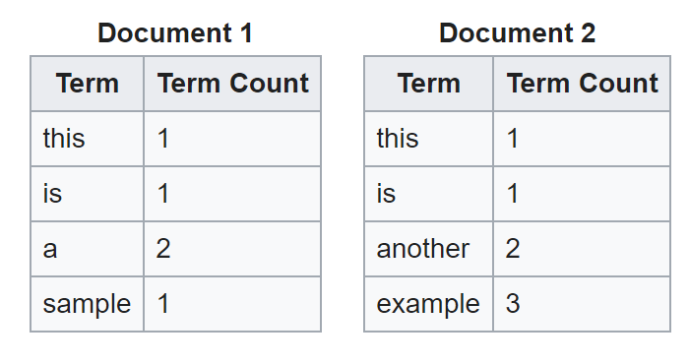
Featurization: Feature Extractors
Term Frequency–Inverse Document Frequency, or TF-IDF,
Suppose that we have term count tables of a corpus consisting of only two documents, as listed on the right.
Calculate TF-IDF for the term "this”.

Slide 12
Featurization: Feature Extractors
TF-IDF (Solution),
Calculating TF for “this”:
TF (“this”, d1) = 1/5 = 0.2
TF (“this”, d2) = 1/7 = 0.14 (Approx.)

Slide 13
Featurization: Feature Extractors
TF-IDF (Solution),
Calculating IDF for “this”:
|D| = 2
DF(t, D) = 2
IDF (“this”, D) = log ( 3/ 3) = 0

Slide 14
Featurization: Feature Extractors
TF-IDF (Solution),
Calculating TF-IDF for “this”:
TF-IDF (“this”, d1, D) = 0.2 * 0 = 0
TF-IDF (“this”, d2, D) = 0.14 * 0 = 0

Slide 15
Featurization: Feature Extractors
Exercise: Calculate TF-IDF for the term “example”.

Slide 16
Featurization: Feature Extractors
Word2Vec
maps each word to a unique fixed-size vector.
transforms each document into a vector using the average of all words in the document.
this vector can then be used as features for prediction, document similarity calculations, etc.
Home Work: Do some research and write a program to find the document similarity using Word2Vec.

Slide 17
Featurization: Extraction, transformation and selection
Extraction
Extracting features from “raw” data
Transformation
Scaling, converting, or modifying features
Selection
Selecting a subset from a larger set of features

Slide 18
Featurization: Feature Extraction and Transformation
Feature Transformers
Tokenization
Stop Words Remover
String Indexing
One Hot Encoding
Vector Assembler (Implement In tutorial)

Slide 19
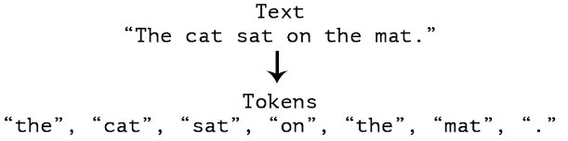
Featurization: Feature Transformers
Tokenization
It is the process of taking text (such as a sentence) and breaking it into individual terms (usually words).

Slide 20
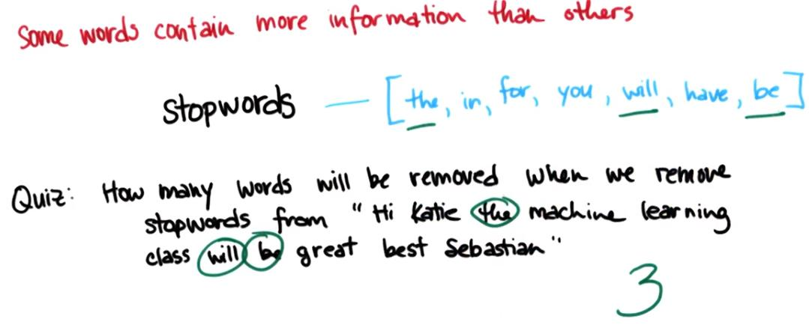
Featurization: Feature Transformers
Stop Words are words which should be excluded from the input, typically because the words appear frequently and don’t carry as much meaning.

Slide 21
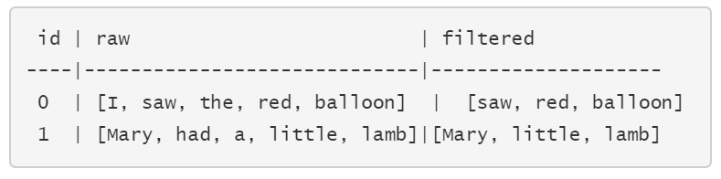
Featurization: Feature Transformers
Stop Words Remover
Takes as input a sequence of strings (e.g. the output of a Tokenizer)
Drops all the stop words from the input sequences.

Slide 22
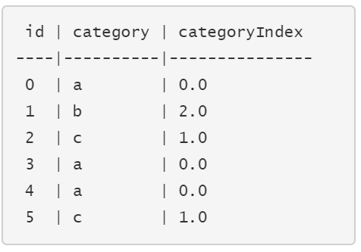
Featurization: Feature Transformers
String Indexing
Encoding a string column of labels to a column of label indices.

Slide 23






Featurization: Feature Transformers
One Hot Encoding
Maps a categorical feature represented as a label index to a binary vector..
A single one-value indicates the presence of a specific feature value from among the set of all feature values.
For string type input data, it is common to encode categorical features using String Indexing first.
Example, three category labels {a,b,c}
In spark, use N-1 dimensional binary vector (N is the number of categories)
$$′a^{′}−\left[\begin{matrix}1 \\ 0 \\ 0\end{matrix}\right]$$
$$′b^{′}−\left[\begin{matrix}0 \\ 1 \\ 0\end{matrix}\right]$$
$$′c^{′}−\left[\begin{matrix}0 \\ 0 \\ 1\end{matrix}\right]$$
$$′a^{′}\left(index \text{0}\right)−\left[\begin{matrix}1 \\ 0\end{matrix}\right]$$
$$′b^{′}\left(index \text{1}\right)−\left[\begin{matrix}0 \\ 1\end{matrix}\right]$$
$$′c^{′}\left(index \text{2}\right)−\left[\begin{matrix}0 \\ 0\end{matrix}\right]$$
Notes:
Some times converting string values to index is not enough.
Next I am going to talk about One Hot Encoding, and when it is necessary to use as a preprocessing step for machine learning models.
One Hot Encoding is a pre-processing step.
It is applied to categorical data, to convert it into a non-ordinal numerical representation.
What that means is it maps a categorical feature represented as a label index to a binary vector..

Slide 24
Featurization: Feature Transformers
Why One Hot Encoding?
For categorical variables when there is no ordinal relationship, the string indexing is not enough...
Using this encoding and allowing the model to assume a natural ordering between categories may result in poor performance or unexpected results.
A one-hot encoding can be applied to the integer representation. This is where the integer encoded variable is removed and a new binary variable is added for each unique integer value.

Slide 25
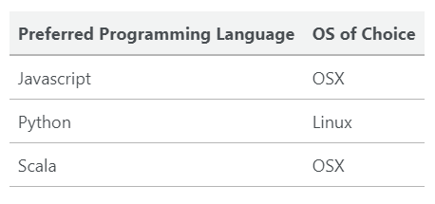
Featurization: Feature Transformers
Why One Hot Encoding?
Example: Let’s say we have 3 data instances with attributes of Preferred Programming Language and OS of Choice.

Slide 26
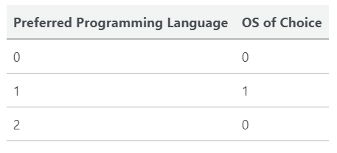
Featurization: Feature Transformers
Why One Hot Encoding?
String Indexing

Slide 27
Featurization: Feature Transformers
Why cant we STOP here?
String Indexing
The Problem Of Ordinality
Machine learning algorithms treat the ordinality of numbers in an attribute with some significance: a higher number “must be better” than a lower number.

Slide 28
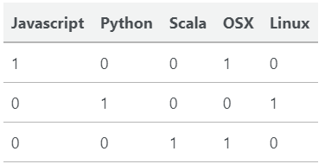
Featurization: Feature Transformers
String Indexing
One Hot Encoding
Homework: Have a look at Principal Component Analysis (PCA)

Slide 29
Featurization: Feature Transformers
Why One Hot Encoding?
For categorical variables when there is no ordinal relationship, the string indexing is not enough...
Using this encoding and allowing the model to assume a natural ordering between categories may result in poor performance or unexpected results.
A one-hot encoding can be applied to the integer representation. This is where the integer encoded variable is removed and a new binary variable is added for each unique integer value.
Notes:
Now Summary of why should we use one hot encoding?
Using string indexing can cause the model to assume a natural ordering between categories.
This may result in poor performance or unexpected results.
A one-hot encoding can be applied to the integer representation.
This is where the integer encoded variable is removed and a new binary variable is added for each unique integer value.
This gets rid of the problem of ordinality.

Slide 30
Featurization: Extraction, transformation and selection
Extraction
Extracting features from “raw” data
Transformation
Scaling, converting, or modifying features
Selection
Selecting a subset from a larger set of features

Slide 31
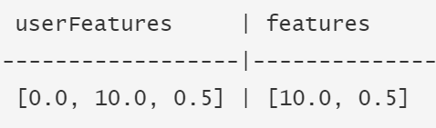
Featurization: Feature Selectors
Feature selection
This process tries to get most important features that are contributing to decide the label.
Vector Slicer
It takes a feature vector and outputs a new feature vector with a sub-array of the original features.
It is useful for extracting features from a vector column.

Slide 32
Lecture Demo
Spam Classification Example

Slide 33
Thank You
See you next week

